Slide 1
Pesta Sukan 2024 ELIMINATION BRACKETS

Slide 2
3X3 Categories

Slide 3
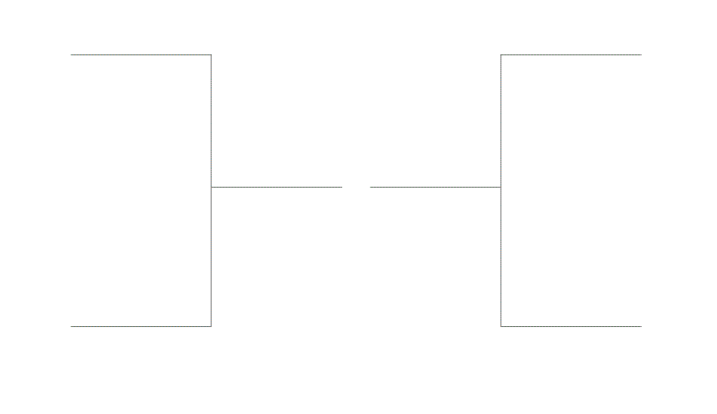
U10 Girls 3X3 Second Round 4 Teams
Academy13 U10 Girls Red
ABA Ducks Legendz
FINALS
Academy13 U10 Girls Red
2ND
ABA Ducks Legendz 1ST
PLACING
GAME
SKEM
ABA B.R.Z
3RD

Slide 4
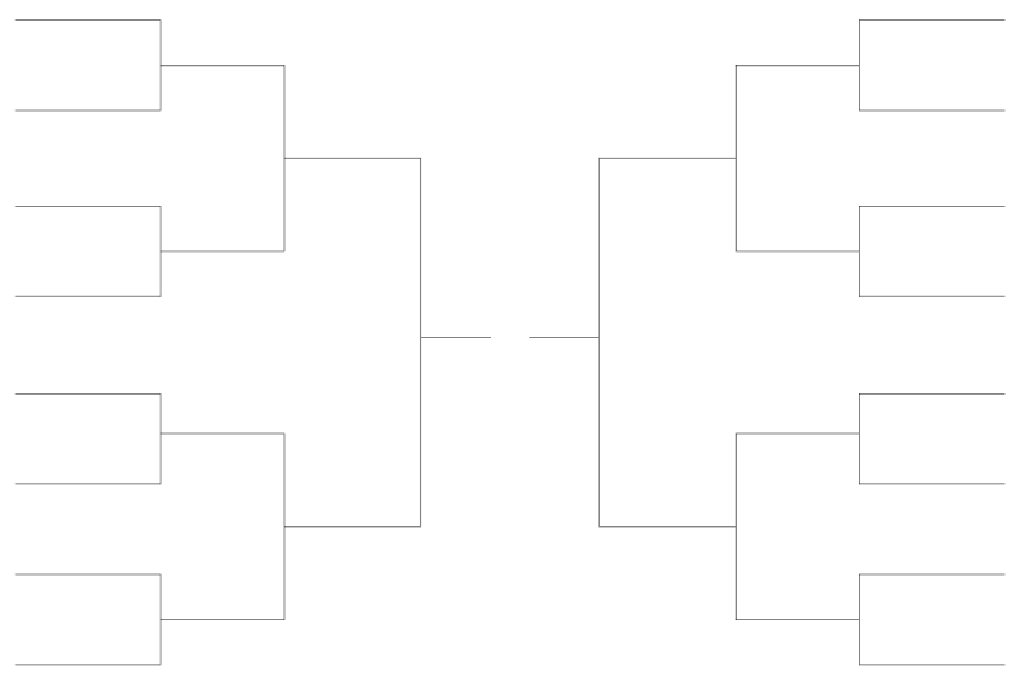
U10 Boys 3X3 Second Round 16 Teams
ABA ACED
SBA
L16 #1
ABA ACED
SBA
L16 #5
D&D Papaya
Wildcats Gold
ABA ACED
SBA
QF #1
QF #3
HOB
Academy13 U10B
L16 #2
L16 #6
ABA (SK) white
FINALS
Academy13 U10B
ABA (SK) white
CJX3
ABA ACED
SBA
SF #1
SF #2
Hoopers
PLACING
GAME
Lions Magic
Lions Hurricane
ABA 2K24
L16 #3
L16 #7
Lions Hurricane
ABA 2K24
QF #2
ABA Warriors
QF #4
ABA Warriors
ACE 10
ABA(SK) Junior Jammers
L16 #4
L16 #8
ABA Warriors
ACE 10
SGB Lion Thunder
ACE 10

Slide 5
U12 Boys 3X3 Second Round 16 Teams
ABA Cobra
little dragons
Swag Ballers
little dragons
L16 #1
L16 #5
Swag Ballers
Swag Ballers
ABA B.A.Y Hawks
QF #1
little dragons
QF #3
BallersForLife(BFL)
SGB Lions Lightning
L16 #2
L16 #6
ABA 3AnK
FINALS
W.A.Y - We Are Young
ABA 3AnK
W.A.Y - We Are Young
Swag Ballers
ABA SG Legends
SF #1
SF #2
P95
PLACING
GAME
ABA SG Legends
L16 #3
P95
ABA SG Legends
L16 #7
Stingers
Thunder Bulls
QF #2
QF #4
ABA Happy Meal
ABA SG Legends
ABA Happy Meal
Academy13 U12 Boys Red
L16 #4
Academy13 U12 Boys Red
L16 #8
ABA Happy Meal
Zenith Basketball Academy
ABA Orangutan

Slide 6
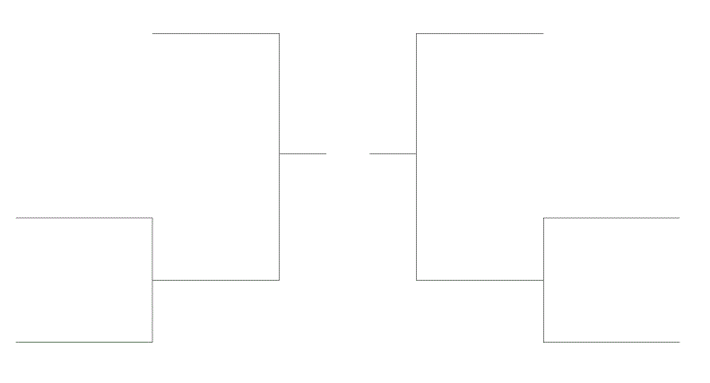
U12 Girls 3X3 Second Round 6 Teams
Academy13 U12 Girls Blue
Academy U12 Girls Red
FINALS
People
Academy U12 Girls Red
SF #1
SF #2
ABA Dunkin Donuts
PLACING
GAME
ABA Gold
QF #1
QF #2
People
ABA Gold
People
ABA Lightning Rocket

Slide 7
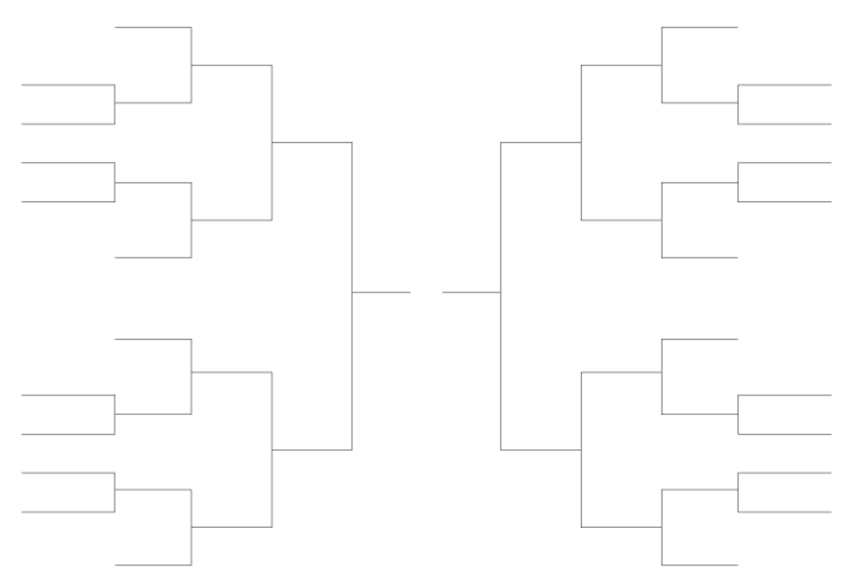
U14 Boys 3X3 Second Round 24 Teams
Academy13 U14 Boys Blue
Long John Silver
ABA Z.P.K.Z
L16 #1
CATS
L16 #5
ABA Z.P.K.Z
CATS
L24 #1
ABA Z.P.K.Z
L24 #5
Airball
QF #1
Huskies
team batgang
CATS
Beta
QF #3
Huskies
oreo
oreo
L24 #2
Huskies
L24 #6
Shazobryes
team batgang
peanut butter
L16 #2
L16 #6
Huskies
FINALS
My little pony
team batgang
team batgang
SF #1
HIMX4
SF #2
Superstigma
PLACING
GAME
The triple tower
Superstigma
The triple tower
L16 #3
L16 #7
Sigmas
JUMPSHOT BOYS
L24 #3
Rainbow Riders
Jumpshot boys
L24 #7
Rainbow Riders
Fried Chicken Cutlet
West Ballers
QF #2
HIMX4
QF #4
Adroit
Fried Chicken Cutlet
L24 #4
Adroit
Fried Chicken Cutlet
L24 #8
FLYING MEATBALLS
Fried Chicken Cutlet
L16 #8
jittleyangs
L16 #4
HIMX4
HIMX4
Apollo 11

Slide 8
U14 Girls 3X3 Second Round 6 Teams
ABA Angry Spanish Bird Heeduo
3rd
ABA GLVZ
FINALS
SF #1
Yerdy
1st
ABA GLVZ
2nd
SF #2
Slasher
PLACING
GAME
ABA WingStop
QF #1
Yerdy
QF #2
Chicken Dinner
4th
Yerdy
Chicken Dinner

Slide 9
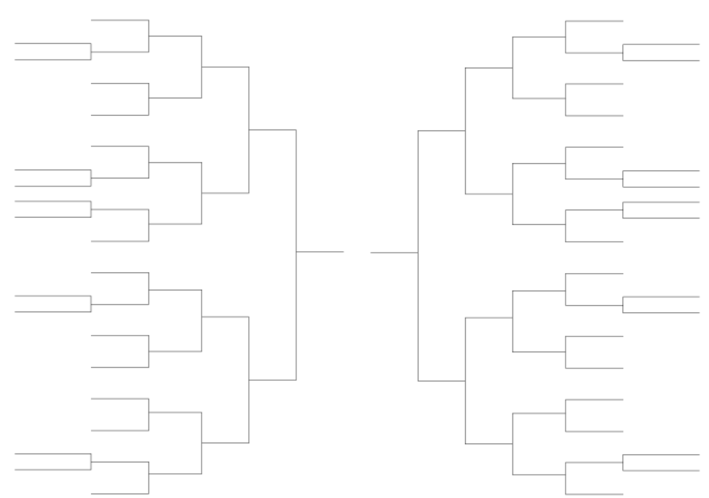
U16 Boys 3X3 Second Round 42 Teams
Kent Ridge
Goofy
L32 #1
Kent Ridge
Goofy
L32 #9
Wood Cottege
L42 #1
Wood Cottage
ABS TROLLERS
Goofy
L42 #6
IRON
SGA Cats
L16 #1
L16 #5
Fabiantai
Fabiantai
Team Lights
Banana
L32 #2
ABS TROLLERS
L32 #10
ABS TROLLERS
Goofy
Banana
Den Team
KKR
QF #1
QF #3
Den Team
WoBuZhiDao
WoBuZhiDao
L32 #3
Den Team
L32 #11
YiMing Kingdom
L42 #2
YiMing Kingdom
Chocolate Roll
AGCE
ABA Zesty Besties
L16 #2
L16 #6
L42 #7
Chocolate Roll
Den Team
Academy13 U16 Boys Blue
Oreo Mcflurry
L42 #3
Pink Barbie Boys
FINALS
PBS
AJBALLERS
Pink Barbie Boys
L32 #4
L42 #8
PBS
ABA TROLLERS
Academy13 U16 Boys Blue
L32 #12
ABA TROLLERS
mcdonalds
Goofy
Academy13 U16 Boys Blue
SF #1
SF #2
Youtubers
Youtubers
Cookie
L32 #5
PLACING
GAME
Cookie
L32 #13
Tomatoe Soup
L42 #4
Tomatoe Soup
Josiah
Cookie
L42 #9
BUILDING HOUSES
skididis
L16 #3
L16 #7
WALKOVER
Legendarystardrop
HORSE
Josiah
maggie goreng
L32 #6
L32 #14
NICK KERR
Josiah
NICK KERR
QF #2
mcdonalds
QF #4
mcdonalds
Cookie
MILO
L32 #7
mcdonalds : Champions
unicornicecream
L32 #15
unicornicecream
mcdonalds
Goofy : Runner Up
Mylittlepony
L16 #4
mcdonalds
Cookie : Second Runner Up
L16 #8
reverse oreo
crocodile
L42 #5
WALKOVER
Den Team : Third Runner Up
crocodile
Winnie the Hong
Weng Yang Yue
crocodile
L42 #10
crocodile
L32 #8
Academy13 U16 Boys Red
L32 #16
Academy13 U16 Boys Red
Automatic Bricks

Slide 10
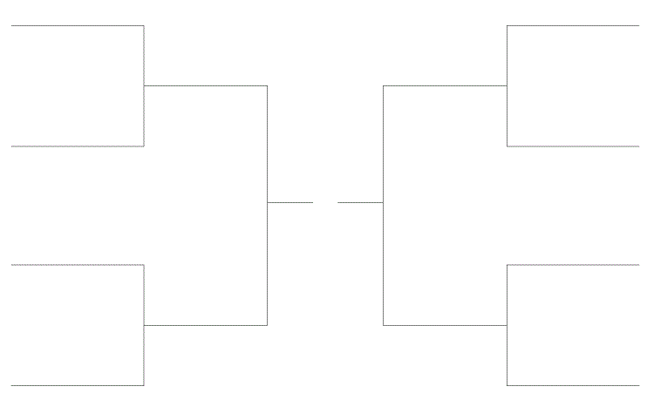
U16 Girls 3X3 Second Round 8 Teams
Academy13 U16 Girls
Jollibee
Academy13 U16 Girls
ABA Fr
QF #1
QF #3
Teletubbies
ABA Fr
FINALS
SF #1
Best Shot
Squishy Ants
SF #2
PLACING
GAME
Barney
Squishy Ants
QF #2
QF #4
Best Shot
Squishy Ants
Best Shot : Champions
Best Shot
Squishy Ants : Runner Up
ABA Vita Punch
Best Shot
ABA Fr : Second Runner Up

Slide 11
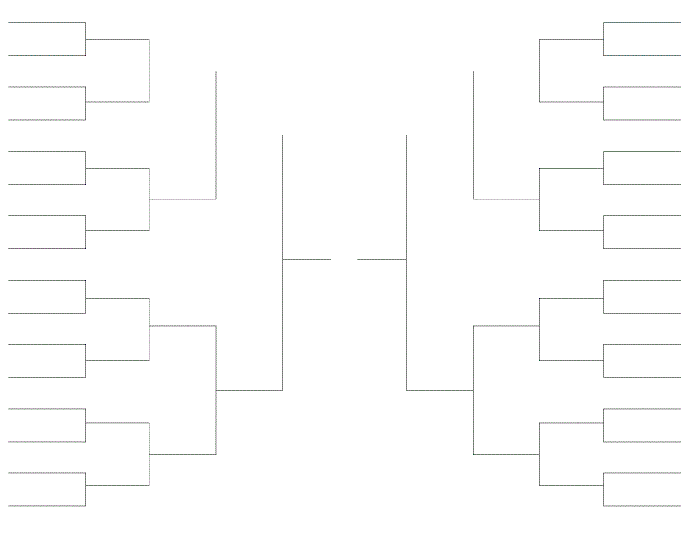
U18 Boys 3X3 Second Round 32 Teams
VJI
JMc
JMc
L32 #1
CJJS
L32 #9
CJJS
Mcsaver
Big mac
JWBC
L16 #1
L16 #5
Team Cedron
Big mac
L32 #2
Mcsaver
Big mac
L32 #10
Mcsaver
Mcsaver
Small Mac
Rose Smurfs
QF #1
QF #3
skibidi sigmas
up
Small Mac
L32 #3
Small Mac
L32 #11
up
Andrew and em
L16 #2
up
L16 #6
TBD
Small Mac
Potato Corner
L32 #4
TBD
FINALS
Potato Corner
L32 #12
Whiskeyonice
Kaixuan
Small Mac
Sixers
SF #1
SF #2
ISPE
ISPE
PLACING
GAME
Cj Villagers
Cj Villagers
L32 #5
L32 #13
Rainbow Baboons
no hopz
Team 8858
Sethurajan
L16 #3
L16 #7
Cream
JAPS
L32 #6
no hopz
L32 #14
no hopz
Team 8858
Team 8858
QF #2
Team 8858
QF #4
skibidi dipity deputies
Sec 5 and
the gifted
Kaixuan
duckywhacky
duckywhacky
L32 #7
L32 #15
Sec 5 and the gifted
Small Mac : Champions
Royal Flush
L16 #4
Kaixuan : Runner Up
L16 #8
Kaixuan
Kaixuan
duckywhacky
Tungsan XY
Team 8858 : Second Runner Up
L32 #16
L32 #8
Kaixuan
Tungsan XY
Ahtuts
Pac man

Slide 12
U18 Girls 3X3 Second Round 8 Teams
Jelly Cat
Academy13 U18 Girls Blue
QF #1
Jelly Cat
Academy13 U18 Girls Blue 3rd
QF #3
Qian Xi
owala
FINALS
Academy13 U18 Girls Red 1st
SF #1
Jelly Cat 2nd
SF #2
PLACING
GAME
YOLO
Academy13 U18 Girls Red
Academy13 U18 Girls Red
YOLO 4th
QF #2
QF #4
Waffles
Cuteballs

Slide 13
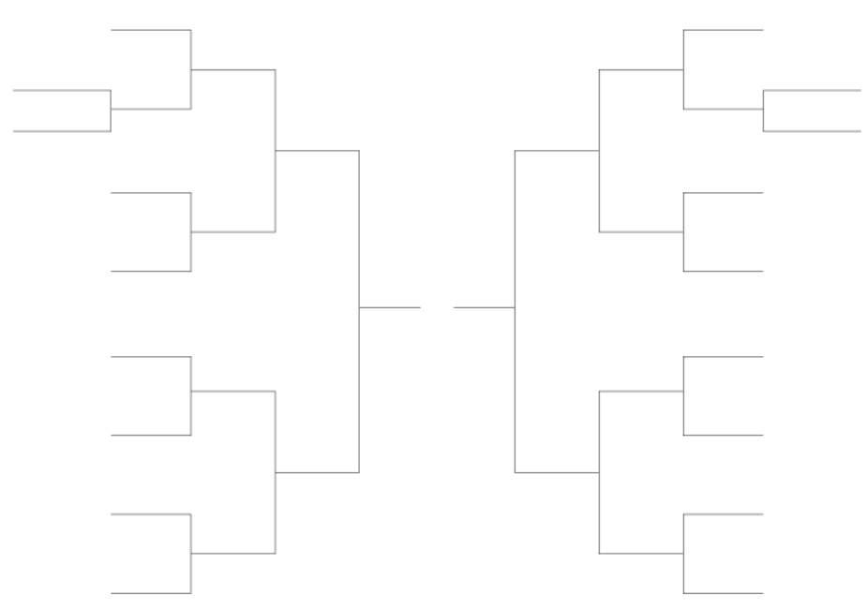
Men’s Open 3X3 Second Round 18 Teams
Primehoops
Swish Kebabs
L16 #1
Primehoops
Swish Kebabs
L16 #5
Team Chunwai
Team KB24
L18 #1
L18 #2
JAK
Team Chunwai
Team KB24
Nus Team 2
QF #1
Primehoops
Swish Kebabs
QF #3
Siglap Csc
Clover
L16 #2
L16 #6
Monkeys
Bruh bruh
Monkeys
FINALS
Bruh bruh
SF #1
Team J
Swish Kebabs
SF #2
Team J
PLACING
GAME
Devest
Team J
Devest
L16 #3
L16 #7
Naked Monkeys
Big Power
QF #2
QF #4
Team J
Devest
KSRJ
Team J : Champions
Rayvinesh leiwei
L16 #4
Swish Kebabs : Runner Up
L16 #8
Easties
Devest : Second Runner Up
Rayvinesh leiwei
Easties
Cookie Monster

Slide 14
Women’s Open 3X3 Second Round 6 Teams
Soyabeans
J3
FINALS
Soyabeans
J3
SF #1
SF #2
Jumpshot
PLACING
GAME
Nee Soon Central CSn (IBA) Team 1
QF #1
Nee Soon Central CSn (IBA) Team 1
QF #2
Jumpshot
Nee Soon Central CSN (IBA)
Team Brickz
Soyabeans : Champion
J3: Runner Up
Nee Soon Central CSn (IBA) Team 1 : Runner Up

Slide 15
Community Championship Second Round 16 Teams
Sengkang Team 2
Pasir Ris-Punggol Team 1
L16 #1
Chua Chu Kang Team 2
Pasir Ris-Punggol Team 1
L16 #5
Chua Chu Kang Team 2
Sengkang Team 1
QF #1
Chua Chu Kang Team 2
Pasir Ris-Punggol Team 1
QF #3
Bishan-Toa Payoh Team 1
Chua Chu Kang Team 2
Ang Mo Kio Team 1
West Coast Team 1
L16 #2
L16 #6
Tanjong Pagar Team 2
FINALS
West Coast Team 1
Tanjong Pagar Team 2
Jurong Team 2
SF #1
SF #2
Chua Chu Kang Team 1
PLACING
GAME
Ang Mo Kio Team 1
Ang Mo Kio Team 1
Chua Chu Kang Team 1
L16 #3
L16 #7
Aljunied Team 2
Chua Chu Kang Team 1
Pasir Ris-Punggol Team 1
East Coast Team 2
QF #2
Chua Chu Kang Team 1
Ang Mo Kio Team 1
QF #4
Marsiling-Yew Tee Team 1
Marine Parade Team 1
L16 #4
Jurong Team 1
L16 #8
Marine Parade Team 2
Marsiling-Yew Tee Team 1
Jurong Team 1

Slide 16
5V5 Categories

Slide 17
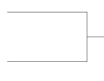
U23 Boys Second Round 9 Teams
UNCAGED
S.F Basketball
UNCAGED
UNCAGED
S.F Basketball
QF #1
QF #3
SP TEAM 1
L9 #1
Best Shot
Sengkang East Aeros
TEPPAN LUNCH
Tong whye
Best Shot
FINALS
SF #1
SF #2
PLACING
GAME
Siglap Csc
Hwa Chong Alumni Association
UNCAGED
S.F Basketball
QF #2
QF #4
Sengkang East Aeros
TEPPAN LUNCH
Sengkang East Aeros
TEPPAN LUNCH

Slide 18
U23 Girls Second Round 6 Teams
KEMBANGAN WHITE
HOOPER
FINALS
KEMBANGAN WHITE
HOOPER
SF #1
SF #2
Nee Soon Central CSN (IBA)
PLACING
GAME
Kembangan Red
UNCAGED SPORTS ASSOCIATION
STARBALM
QF #1
QF #2
UNCAGED SPORTS ASSOCIATION
STARBALM

Slide 19
Men’s 40 & Above Second Round 9 Teams
MACPHERSON
TWP Atlantic Monsters
MACPHERSON
MOUNTBATTEN CSN
QF #1
QF #3
YUHUA
L9 #1
MOUNTBATTEN CSN
YUHUA
MACPHERSON
FINALS
MOUNTBATTEN CSN
Paya Lebar XF
SF #1
SF #2
T.E.A.M
PLACING
GAME
Pasir Ris East CSN
T.E.A.M
WHYE NAM
QF #2
QF #4
Pasir Ris East CSN
SAFEWELL
Pasir Ris East CSN

Slide 20
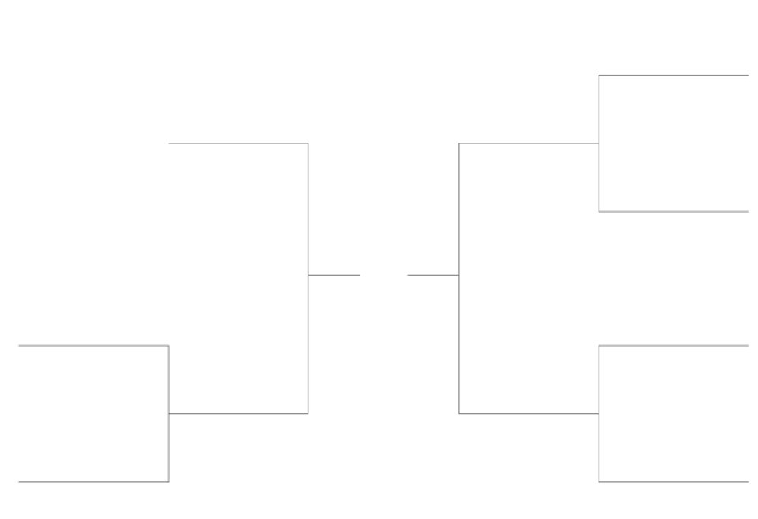
Men’s 45 & Above Second Round 7 Teams
Marist
Marist
TWP
QF #2
FINALS
FEI TENG LOGISTICS SERVICES
Sunrise BC
SIGLAP BASKETBALL CLUB
SF #1
SF #2
TWP
PLACING
GAME
Marist
Geylang Serai CSN
FEI TENG LOGISTICS SERVICES
QF #1
SIGLAP BASKETBALL CLUB
FEI TENG LOGISTICS SERVICES
QF #3
SIGLAP BASKETBALL CLUB
AHS Alumni

Slide 21
Men’s 50 & Above Second Round 6 Teams
MacPherson 50s
Toa Payoh East CSN
Team Knightz
FINALS
MARIST
SF #2
OCEAN
MacPherson 50s
PLACING
GAME
Toa Payoh East CSN
Admiralty CSN
QF #1
QF #2
Team Knightz
MARIST
Team Knightz
MARIST

Slide 22
Men’s Corporate Second Round 16 Teams
LTA
SAFSA Team 1
SG BASKETBALL
MIDAS SPORTS
L16 #1
L16 #5
MIDAS SPORTS
MIDAS SPORTS
SAFSA Team 1
QF #1
MHA
QF #3
Team Equinix
STANDARD CHARTERED BANK SINGAPORE
L16 #2
SAFSA Team 2
MHA
L16 #6
MAYBANK
MAYBANK
FINALS
MHA
MHA
SF #1
SF #2
OC LIONS
OC LIONS
PLACING
GAME
Boeki Auto Pte Ltd
Boeki Auto Pte Ltd
L16 #3
SAFSA TEAM 3
L16 #7
MIDAS SPORTS
CEDRON
STU MOE 3
QF #2
SAFSA Team 2
SAFSA TEAM 3
QF #4
SAFSA Team 2
SAFSA TEAM 3
L16 #4
L16 #8
SAFSA Team 2
SAFSA TEAM 3
KPMG
Sailors

Slide 23
Men’s Open 79 Teams 2 Conferences : Majulah & Singapura
Paya Lebar Youth
Eng Tat Hornets
PESTA SUKAN
GRAND FINALS
Paya Lebar Youth
Eng Tat Hornets
Majulah Conference Finals
Singapura Conference Finals
Siglap Basketball Team
PLACING
GAME
Botanical Bros
Siglap Basketball Team
Botanical Bros

Slide 24
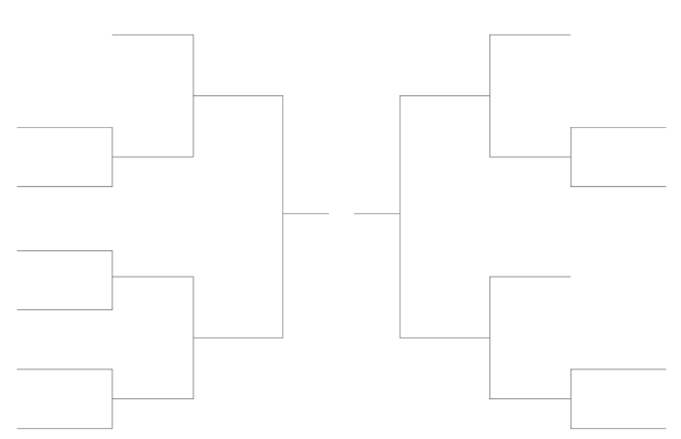
Men’s Open Majulah Conference Second Round 13 Teams
Boon Lay CSN
Nanyang Blue
Paya Lebar Youth
Heng Yew
QF #1
QF #3
Tungsan(HY)
Heng Yew
L13 #1
Paya Lebar Youth
L13 #4
CONFERENCE
FINALS
Heng Yew
Dwolf
Paya Lebar Youth
SF #1
SF #2
Paya Lebar Youth
Siglap Basketball Team
SENGKANG EAST AEROS
SENGKANG EAST AEROS
Milky Dragons (??)
L13#2
Paya Lebar White
QF #2
Jurong Central
QF #4
Jurong Central
Siglap Basketball Team
Paya Lebar Blue
L13 #3
L13 #5
Jurong Central
Siglap Basketball Team
Siglap Basketball Team
Loaded

Slide 25
Men’s Open Singapura Conference Second Round 13 Teams
BUKIT TIMAH CSN
CLEMENTI
Changi Simei CSN
Botanical Bros
QF #1
QF #3
Changi Simei CSN
TEAM BLAZE
L13 #1
L13 #4
Changi Simei CSN
CONFERENCE
FINALS
Botanical Bros
AMK-HG
Botanical Bros
SF #1
Botanical Bros
SF #2
Eng Tat Hornets
Eng Tat Hornets
Eng Tat Hornets
L13#2
XH Huskies
The Invader
QF #2
QF #4
Eng Tat Hornets
XH Huskies
Team Spirit
Hornbills
L13 #3
L13 #5
JDC
Team Spirit
Tungsan
Tungsan

Slide 26
Women’s Open Second Round 6 Teams
Pelle
Cyclone BC
FINALS
SF #1
Pelle
Pepe
SF #2
STARBALM Blue
PLACING
GAME
STARBALM Blue
STARBALM Blue
QF #1
QF #2
STARBALM Blue
Pepe
A1TITUDE
Radin Mas Huskies

